Slide 1
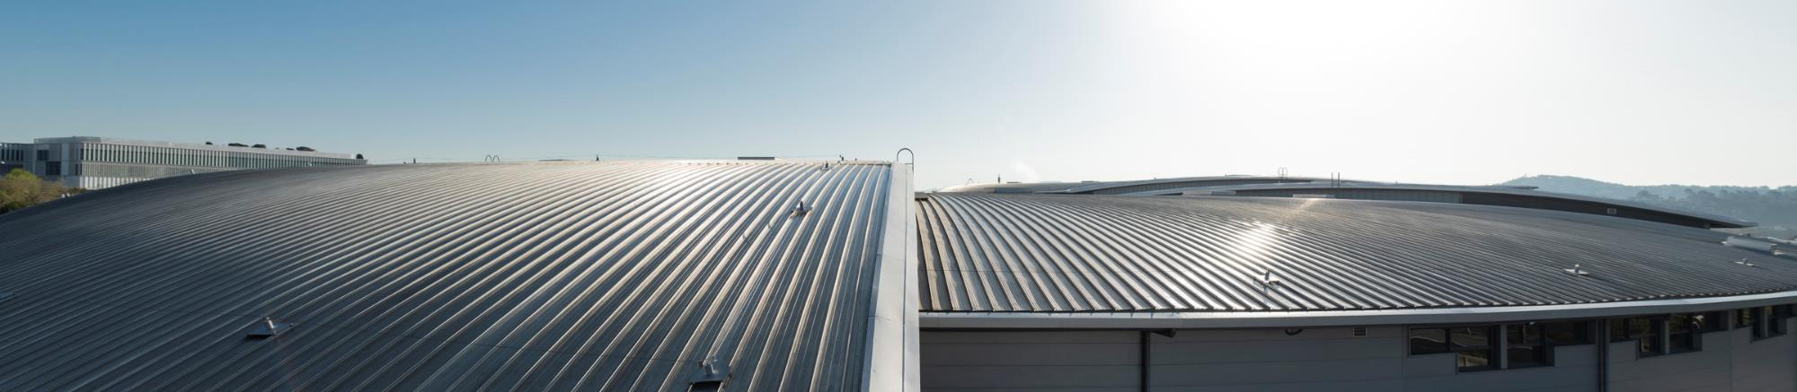
Development of new DLLRF for ALBA and ALBA II, for the main and the 3rd harmonic RF systems.

Slide 2
Outlook
Introduction
ALBA
ALBA II
Harmonic RF system
Main RF system
LLRF upgrade
Hardware
Controls
Firmware
TBL compensation
Conclusions
On Behalf of the ALBA RF team
LLRF engineer: Hamed Shaker (hshaker@cells.es)

Slide 3
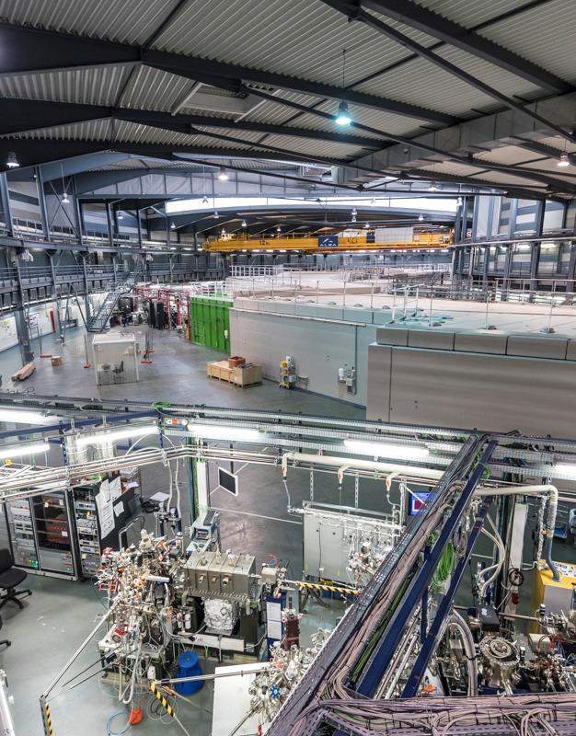
ALBA
ALBA is the Spanish 3rd generation synchrotron light source located in Barcelona.
13 beamlines are currently in operation dedicated to life and material science, solid-state physics + 2 more under construction.
4440 hours of beamlines operation for up to 2250 academic and industrial users.
Parameter | Value | Unit
Energy | 3.0 | GeV
Current | 250 | mA
Circumference | 268.8 | m
Momentum compaction factor | 8.9E-4 | -
Loses per turn | 1.1 | MeV
Emittance | 4.5 | nm·rad
ALBA Experimental Hall

Slide 4
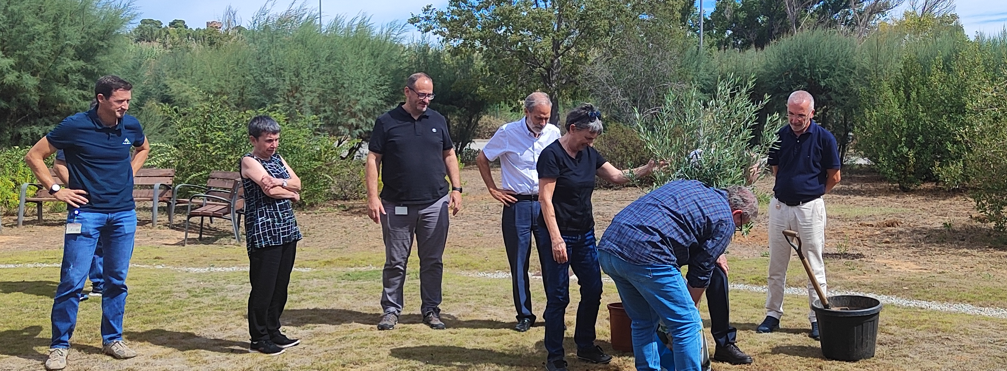
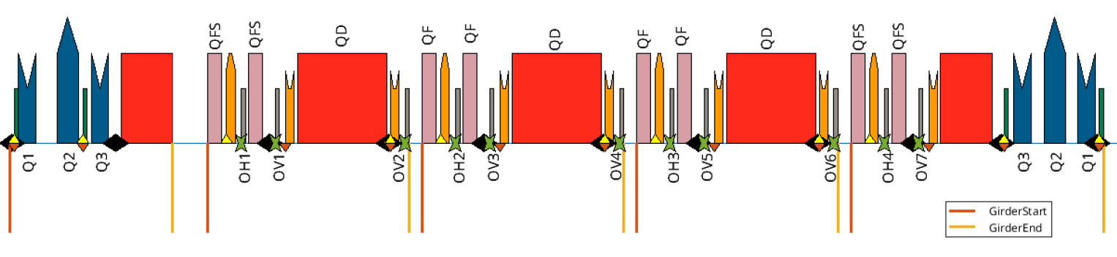
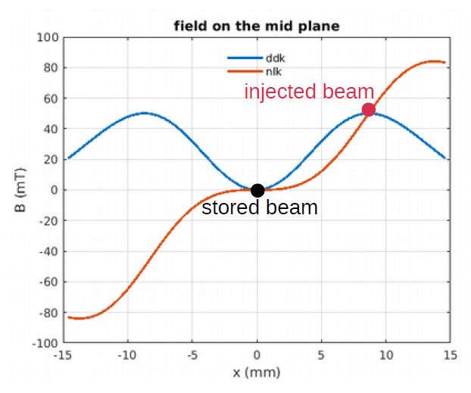
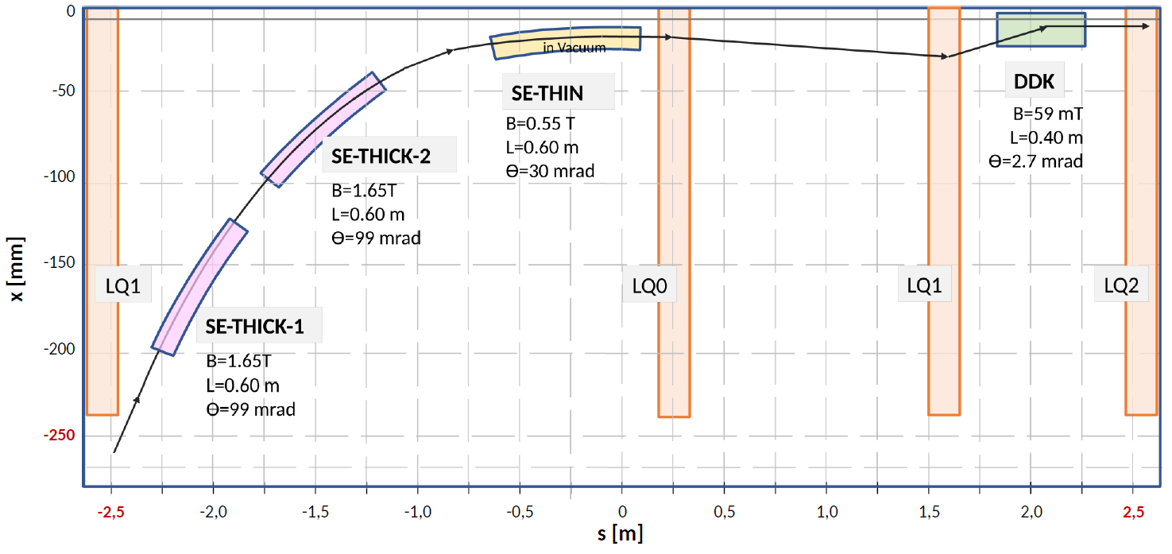
ALBA II
ALBA II is the 4th generation synchrotron machine that will replace ALBA in 2032.
Construction budget for ALBA II and interannual operation budget until 2038 approved by the national Spanish and regional Catalan governments on 09th of September.
Major operational changes with respect ALBA:
From 2DA –> 5BA.
Multipole kicker injection scheme.
NEG coated rhomboidal vacuum chamber 20x16mm.
Active NC 3rd harmonic RF system at 1.5 GHz
...
Parameter | Value | Unit
Energy | 3.0 | GeV
Current | 300 | mA
Circumference | 268.8 | m
Momentum compaction factor | 1,01E-4 | -
Loses per turn | 1.07 | MeV
Emittance | 200 | pm·rad
A tree for ALBA II
ALBA II Lattice (provisional)
ALBA II DDK and Injection scheme (provisional)
F. Perez et al., "ALBA II accelerator upgrade project status", in Proc. IPAC'25, Taipei, Taiwan, Jun. 2025, pp. 706-709. doi:10.18429/JACoW-IPAC25-MOPS043

Slide 5
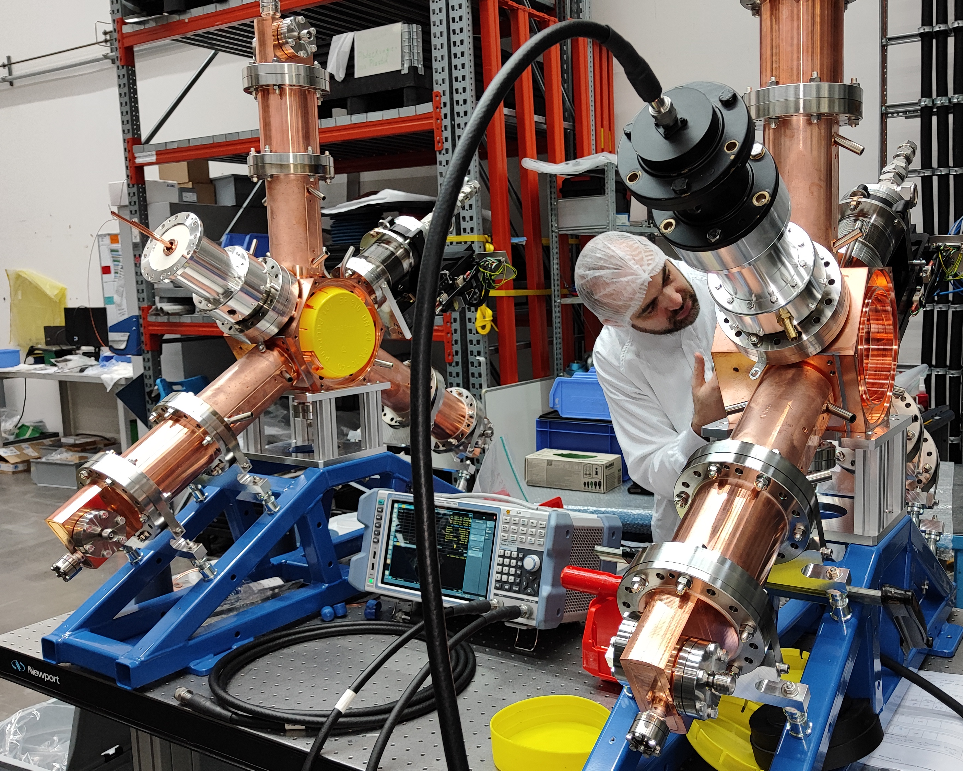
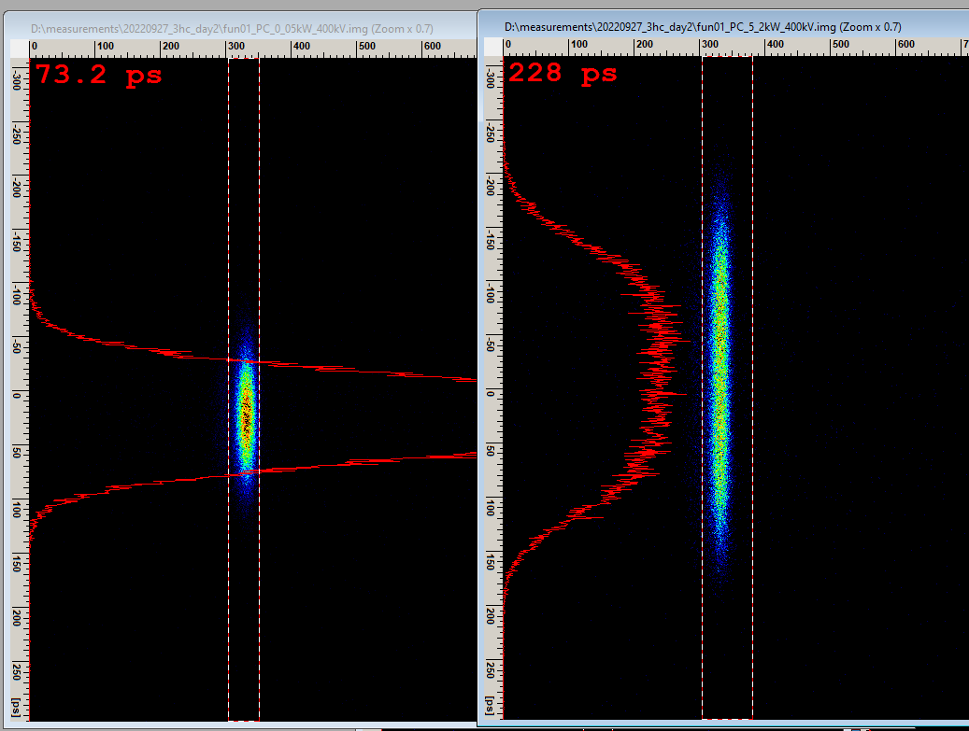
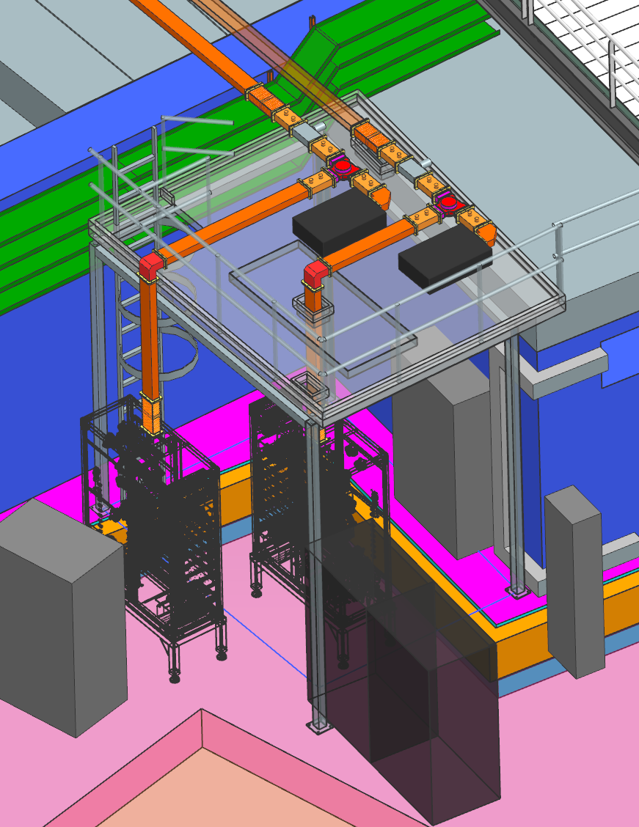
Harmonic RF system
4x NC harmonic cavities to be installed in ALBA during 2026.
Harmonic EU cavity designed by ALBA and commissioned in BESSY II ring under the ALBA-HZB-DESY agreement.
Design parameters fulfilled and high current close to quartic potential reached (u=3).
Active cavity feed with 20 kW SSPA.
Brand new LLRF system for 1.5 GHz.
3HC Research Instruments factory test
ALBA-HZB-DESY 3HC commissioning
3rd harmonic system SSPA+WG
F. Pérez et al., “Active harmonic EU cavity: Commissioning and operation with beam”, Nuclear Instruments and Methods in Physics Research Section A, Volume 1072, 2025, 170195, ISSN 0168-9002, https://doi.org/10.1016/j.nima.2024.170195.
P. Solans et al., "Active 3rd harmonic RF system for ALBA", in Proc. IPAC'25, Taipei, Taiwan, Jun. 2025, pp. 1695-1698. doi:10.18429/JACoW-IPAC25-WEBD2

Slide 6
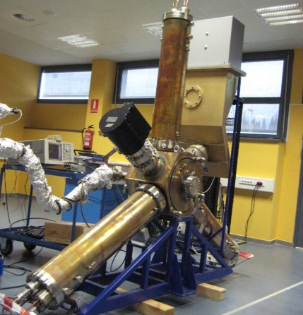
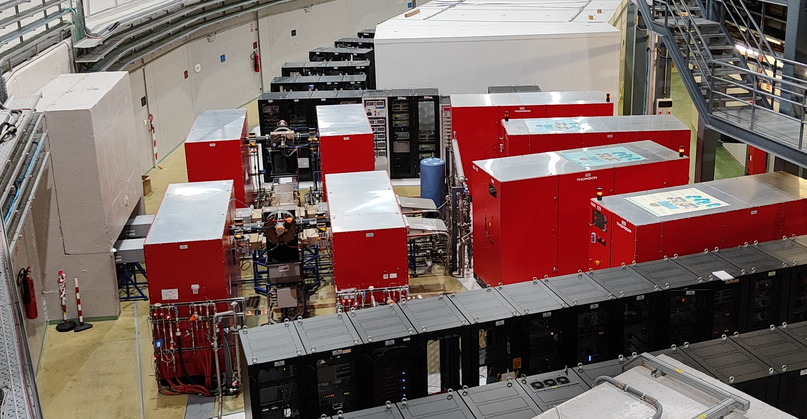
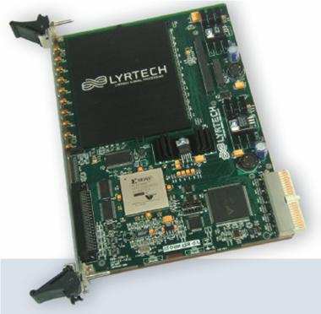
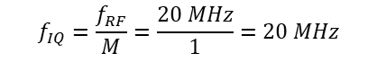
Main RF system
6x NC EU damped cavity at 500 MHz feed by 2x 80 kW IOT each.
Power is combined in a Cavity Combiner (CaCo) and isolated by circulator + RF load.
LLRF based in the Lyrtech VHS-ADC board.
16x ADC and 2x DAC with 14 bit
32x GPIO
ADC clock at 80 MHz
Down/up conversion to/from IF 20 MHz.
VCXO based LO and ADC clock generation.
System in operation since 2012 and exported to other facilities: MAX IV, Sirius, Diamond, CLS, Solaris …
$$f_{IQ}=\frac{f_{RF}}{M}=\frac{20 MHz}{1}=20 MHz$$
EU HOM damped cavity
High power amplifiers and WG
VHS-ADC from Lyrtech

Slide 7

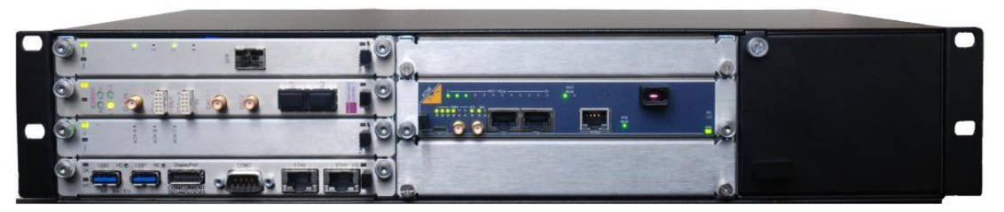
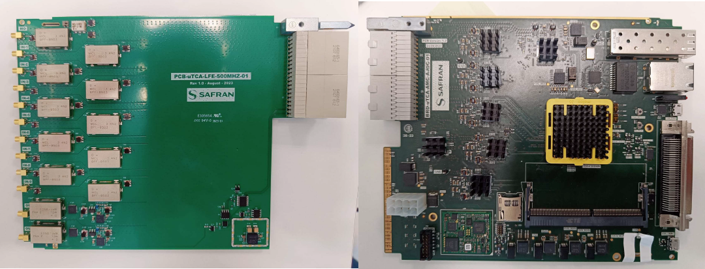
Hardware: 500 MHz
SAFRAN produced and delivered custom made design of the fundamental LLRF system including:
uTCA platform NATIVE-R2 Chassis.
SoC Zynq UltraScale+ FPGA from Xilinx.
20x ADC: 250 MSPS and 16 bit (P_{IN,MAX}: 10 dBm).
4x DAC: 2.5 GSPS and 16 bit (P_{OUT,MAX}: 8 dBm ).
64x GPIO.
2 GB DDR4 memory for postmortem analysis: 32 bits @ 160 MHz.
No down/up conversion: Direct sampling.
External reference: Master oscillator.
MO
AMC Board
RTM Board

Slide 8
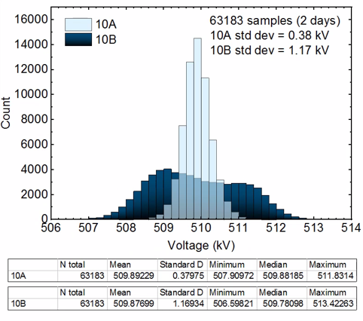
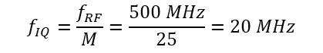
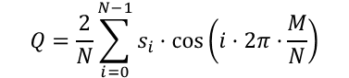
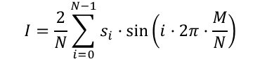
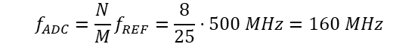
Hardware: 500 MHz
Direct sampling RF = 500 MHz for fundamental system.
No IF for down/up conversion.
Precision improved due to twice frequency sampling and 16 bit.
Long drift also reduced due analogue electronics reduction.
$$I=\frac{2}{N}\sum_{i=0}^{N−1}{s_{i}·\sin\left(i·2π·\frac{M}{N}\right)}$$
$$Q=\frac{2}{N}\sum_{i=0}^{N−1}{s_{i}·\cos\left(i·2π·\frac{M}{N}\right)}$$
$$f_{ADC}=\frac{N}{M}f_{REF}=\frac{8}{25}·500 MHz=160 MHz$$
$$f_{IQ}=\frac{f_{RF}}{M}=\frac{500 MHz}{25}=20 MHz$$
ADC and DAC precision
Channel | Amp (%) | Phase (Deg)
ADC1-9 | 0,05 | 0,03
DAC1-2 | 0,026 | 0,05
Old and new 500 MHz precision comparison

Slide 9
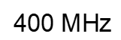
Hardware: PLL
PLL for low phase noise distribution clocks based in MO reference
100 MHz
RTM PLL parameters for 500 MHz case

Slide 10
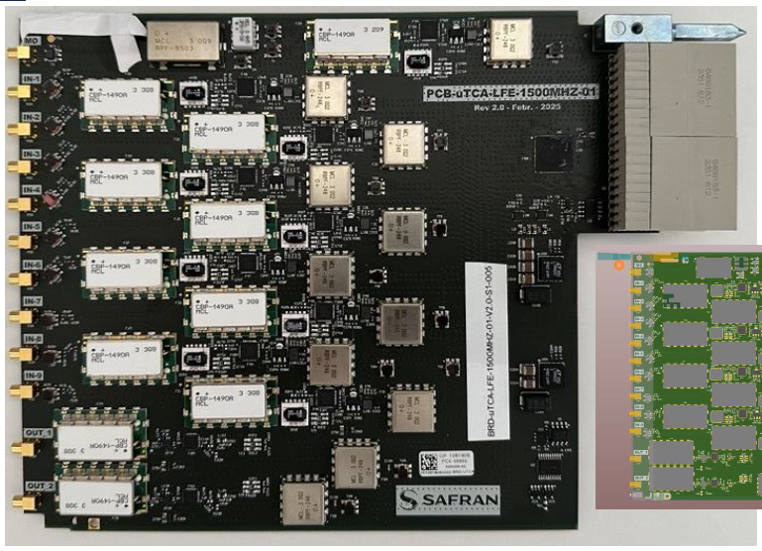
Hardware: 1.5 GHz
CfT awarded to SAFRAN for custom made design and manufacture of LLRF for fundamental and harmonic systems including:
uTCA platform NATIVE-R2 Chassis.
SoC Zynq UltraScale+ FPGA from Xilinx.
20x ADC: 250 MSPS and 16 bit (P_{IN,MAX}: 10 dBm).
4x DAC: 2.5 GSPS and 16 bit (P_{OUT,MAX}: 8 dBm ).
64x GPIO.
2 GB DDR4 memory for postmortem analysis: 32 bits @ 160 MHz.
Down/up conversion: IF = 250 Mhz.
External reference: Master oscillator.
uTCA chassis
MO
AMC Board
RTM Board

Slide 11
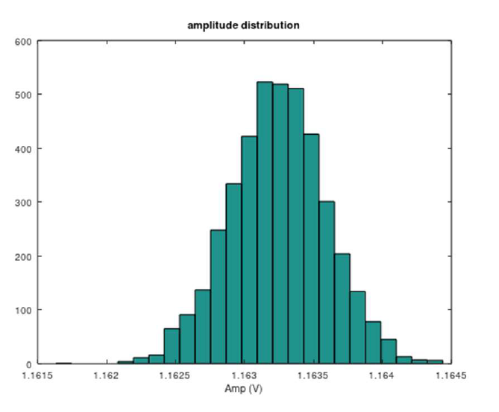
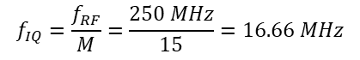
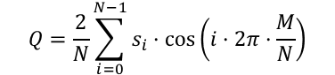
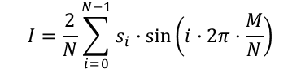
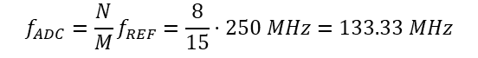
Hardware: 1.5 GHz
Downconversion to IF=250 MHz in harmonic system.
IF = 500 MHz avoided due to undesired coupling.
$$I=\frac{2}{N}\sum_{i=0}^{N−1}{s_{i}·\sin\left(i·2π·\frac{M}{N}\right)}$$
$$Q=\frac{2}{N}\sum_{i=0}^{N−1}{s_{i}·\cos\left(i·2π·\frac{M}{N}\right)}$$
$$f_{ADC}=\frac{N}{M}f_{REF}=\frac{8}{15}·250 MHz=133.33 MHz$$
$$f_{IQ}=\frac{f_{RF}}{M}=\frac{250 MHz}{15}=16.66 MHz$$
ADC and DAC precision
Channel | Amp (%) | Phase (Deg)
ADC0 (ref.) | 0,041 | 0,028 (500 MHz)
ADC1-9 | 0,026 | 0,047 (1,5 GHz)
DAC1-2 | 0,023 | 0,028 (1,5 GHz)
Amplitude and phase precision measurements

Slide 12
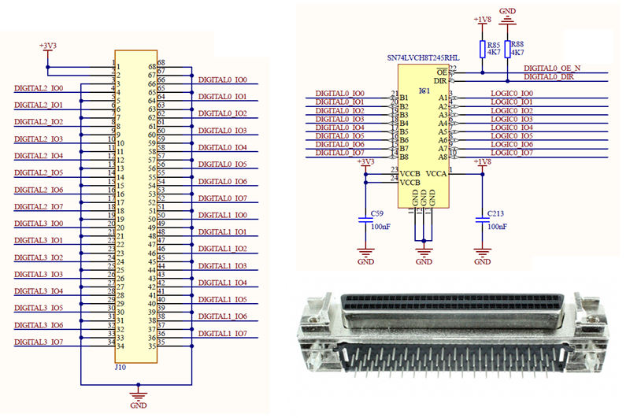
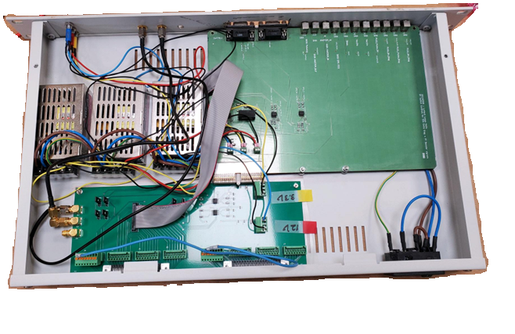
HARDWARE: GPIO
Front panel high density THT D-Type connector for 32 GPIO
Enable and direction controlled by FPGA
3,3 V auxiliar voltage available
Digital Patch Panel as interface between FPGA DIO and RF auxiliaries
Cavity plunger, interlock, timing trigger for Trip compensation, automatic conditioning,…
GPIO Patch Panel

Slide 13
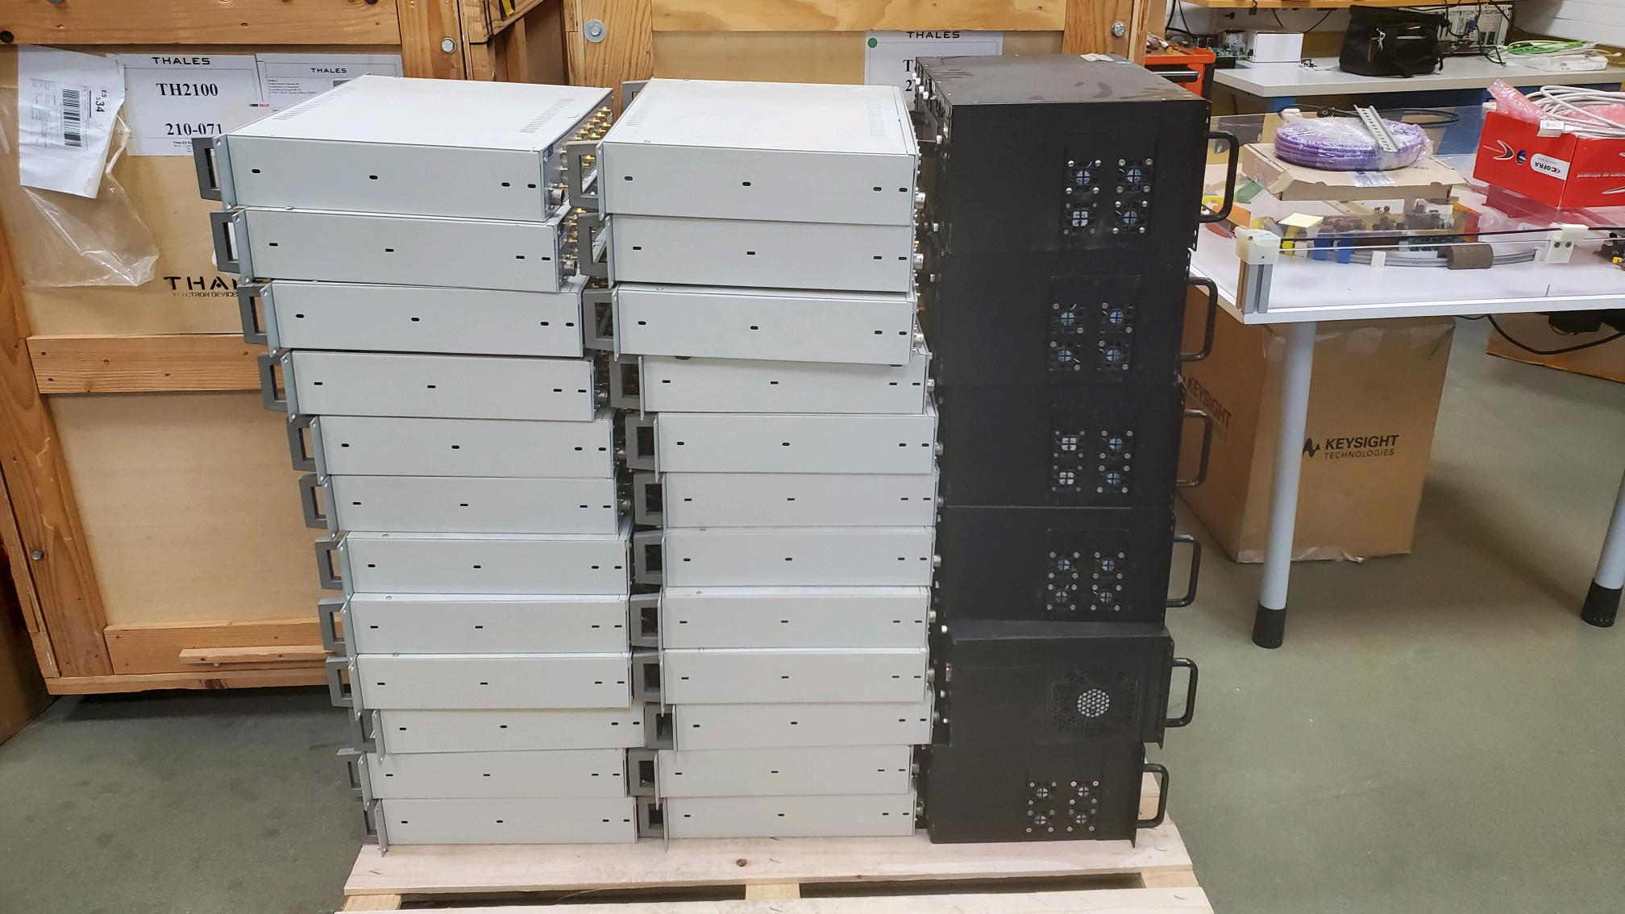
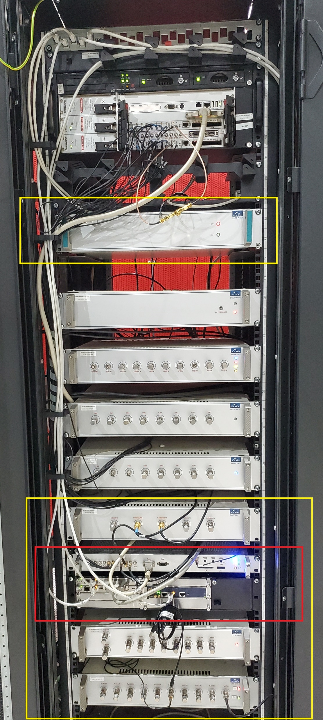
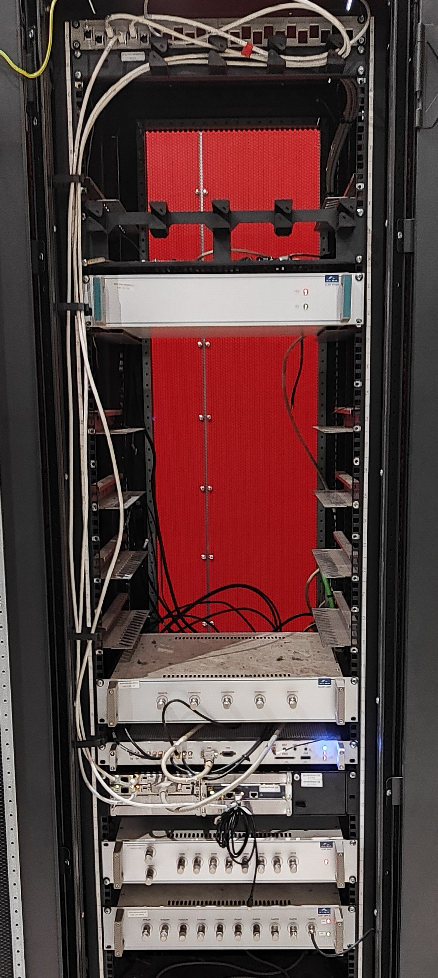
HARDWARE: Operation
Fundamental LLRF system has been replaced already in all the 6x ALBA cavities.
cPCI and analogue crates removed from SA
Before upgrade
After upgrade

Slide 14
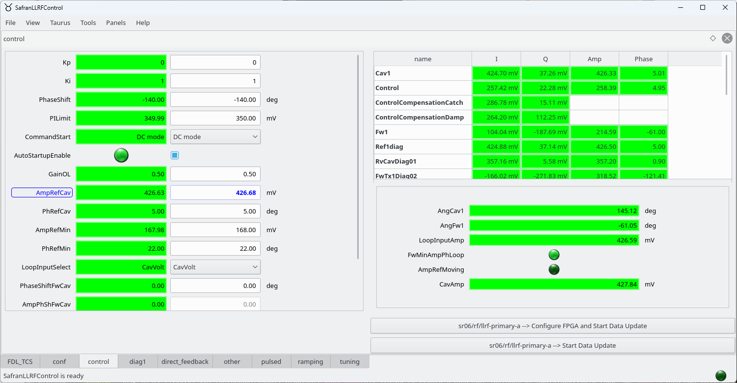
Controls
SAFRAN provided Device Server generator code and ALBA developed the Graphical User Interface.
Both DS and GUI are autogenerated from YAML files and allows fast generation in case of new settings or diagnostics are needed.
LLRF control GUI

Slide 15
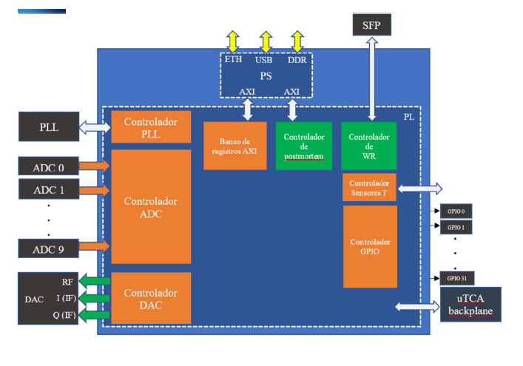
Firmware
SAFRAN provided peripheral firmware controller needed to operate the system:
PLL
ADC
DAC
AXI register
GPIO
Temperature
DMA (Postmortem)
Previous code adapted with modification in the interfaces with the peripheral controllers.
ALBA
FIRMWARE
FIRMWARE general diagram

Slide 16
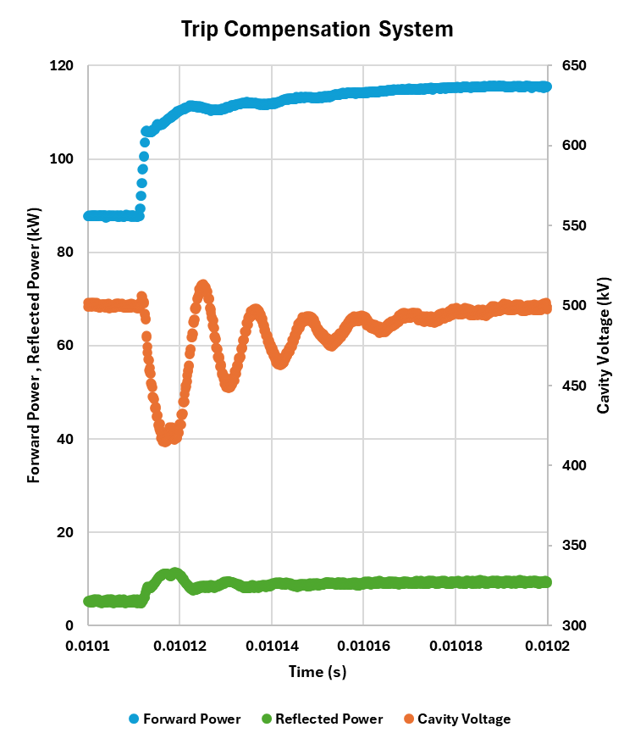

Firmware
All previous features developed by ALBA are available including:
Amplitude and phase loop (I controller).
Direct Feedback (P-on-PV).
Trip Compensation.
Postmortem analysis.
Tuning and field flatness loop.
Parking and automatic recovery of the cavity after a trip.
PI with P-on-PV
Trip compensation
Ref.
$${k_{i}}/s$$
To cavity
+
+
+
-
+
From timing
From cavity
Feedback and trip compensation diagram
Postmortem data of trip compensation
P. Solans et al., "Digital direct RF feedback for beam loading reduction at ALBA", in LLRF WS, Gyeongju, South Korea, 2023

Slide 17
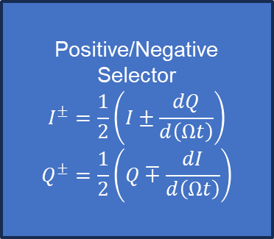
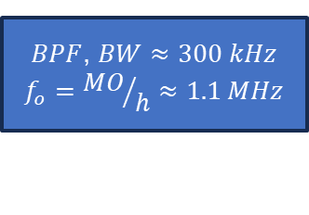
Firmware: Harmonic feedback
Harmonic Resonant feedback drive allows to send revolution harmonic content to cavities.
Digital BPF with f_{o}= rev. freq.; 300 kHz Bandwidth.
Internal calculation of upper and lower revolution mode.
Complex gain for each component.
Feedback source can be chosen between:
External reference
Cavity voltage: Mode +-1 feedback
PI+TC
Positive/Negative
Selector
$$I^{±}=\frac{1}{2}\left(I±\frac{dQ}{d\left(Ωt\right)}\right)$$
$$Q^{±}=\frac{1}{2}\left(Q∓\frac{dI}{d\left(Ωt\right)}\right)$$
+
To cavity
+
$BPF$, $BW≈300 kHz$
$$f_{o}={MO}/h≈1.1 MHz$$
+
MUX
From cavity
External
Harmonic feedback diagram
S. Shaker et al., "Development of a 500 MHz direct RF sampling low-level RF system for ALBA and ALBA-II", in Proc. IPAC'25, Taipei, Taiwan, Jun. 2025, pp. 3222-3225. doi:10.18429/JACoW-IPAC25-THPS133

Slide 18
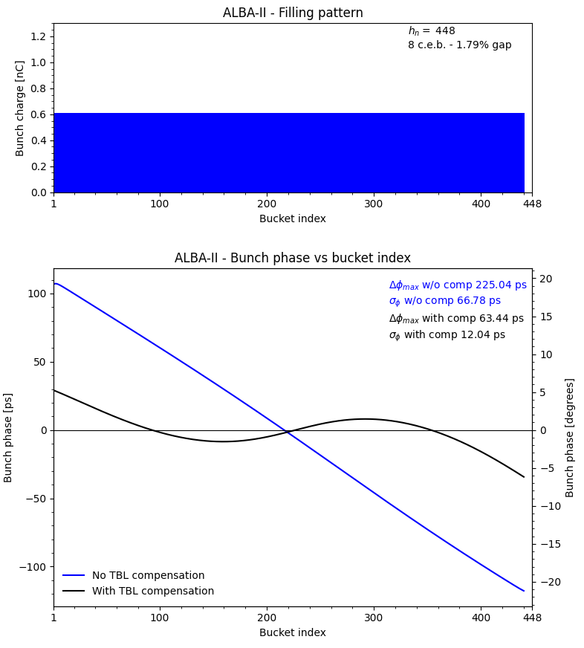
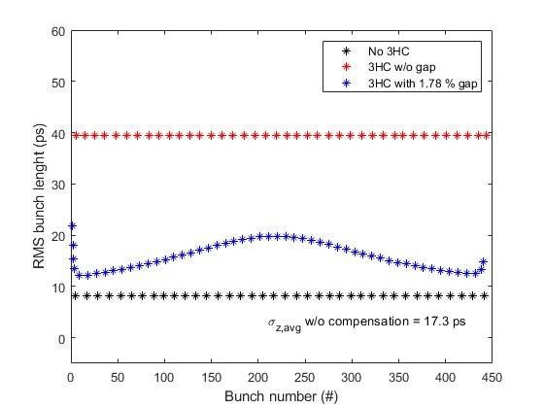
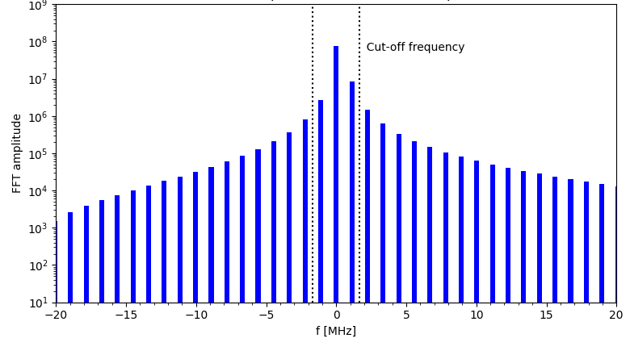
TBL compensation
Ion cleaning gap induces TBL in the cavities, that ultimately ruins the lengthening of the harmonic system.
ALBA II expected filling pattern includes 8 empty buckets.
Self consistent iterative code developed for TBL simulation to take into account this effect.
ALBA II filling pattern
Simulated ALBA II filling pattern and cavity harmonic content
Simulated arrival phase
Simulated bunch length vs. bucket

Slide 19
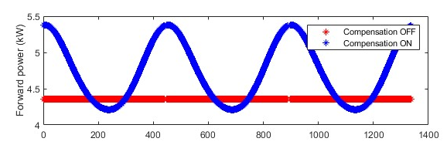
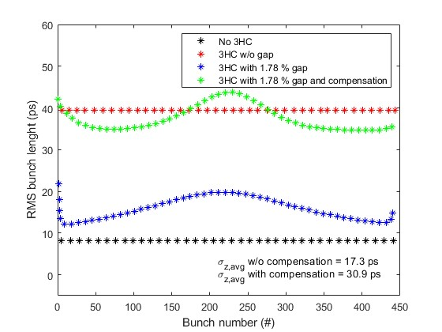
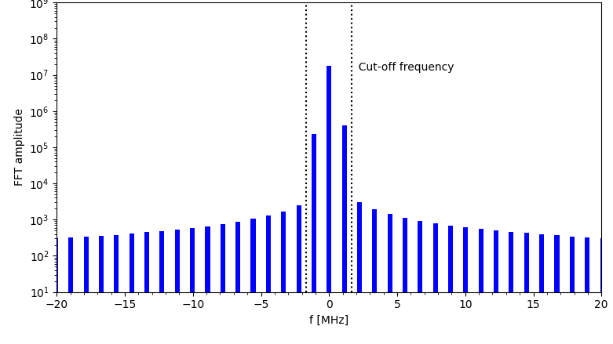
TBL compensation
By suppressing the harmonic content of the cavity the bunch length is partially recovered.
+/- 1 components are dominant in the TBL effects in the beam.
Harmonic feedback with external reference can be used for TBL compensation.
Simulated forward power modulation
Simulated ALBA II filling pattern and cavity harmonic content
with compensation
Simulated arrival phase vs. bucket
Simulated bunch length vs. bucket
N. Yamamoto, et al., “Reduction and compensation of the transient beam loading effect in a double rf system of synchrotron light sources”, PRAB 21, 012001 (2018).

Slide 20
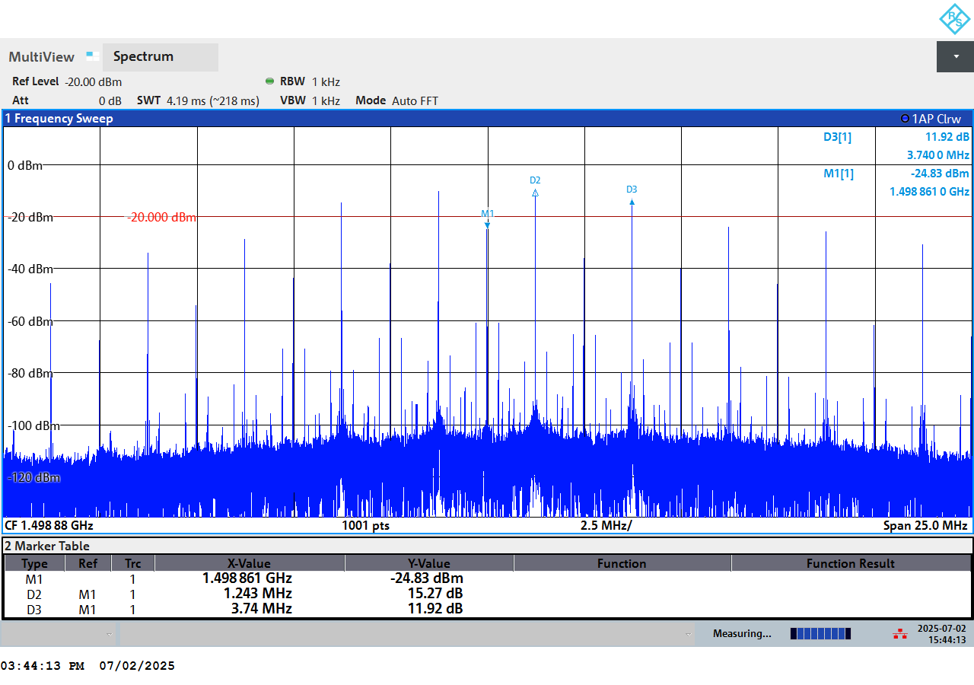
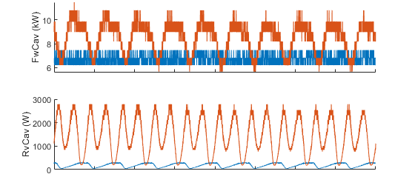
TBL compensation
Compensation applied during 3HC commissioning in BESSY II.
Current: 300 mA, Main RF Voltage: 0.7 MV (2 cavities parked, 2 with detuning -25 deg.), Landau cavities: parked, Fill pattern: 25% gap, 3HC: 130 kV (detuning 0 deg).
External reference built with analogue mixer and filtered using digital harmonic resonant feedback.
HFB OFF, HFB ON
3x MO=1,5 GHz
Rev. Freq.~1 MHz
External reference
experimental setup
External reference harmonic content
Forward and reflected power
with and w/o compensation measurements

Slide 21
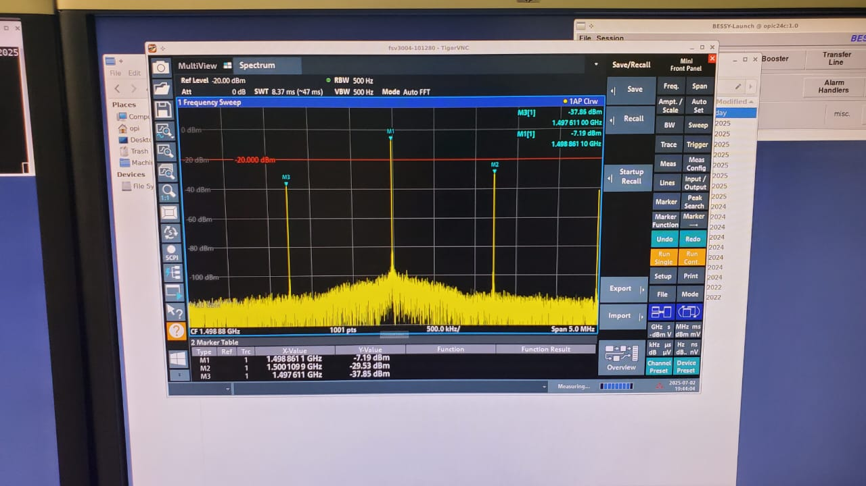
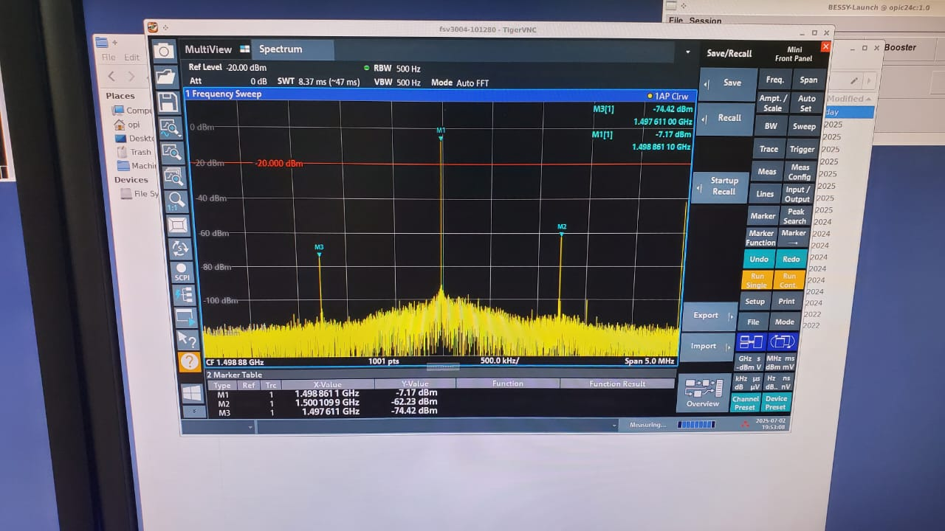
TBL compensation
Compensation applied during 3HC commissioning in BESSY II.
Current: 300 mA, Main RF Voltage: 0.7 MV (2 cavities parked, 2 with detuning -25 deg.), Landau cavities: parked, Fill pattern: 25% gap, 3HC: 130 kV (detuning 0 deg).
Harmonic content of the cavity is reduced by ~ -30 dB.
Cavity harmonic content w/o compensation
Cavity harmonic content with compensation

Slide 22
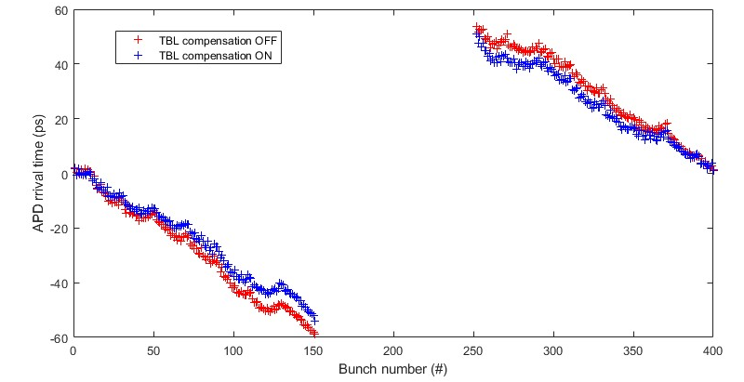
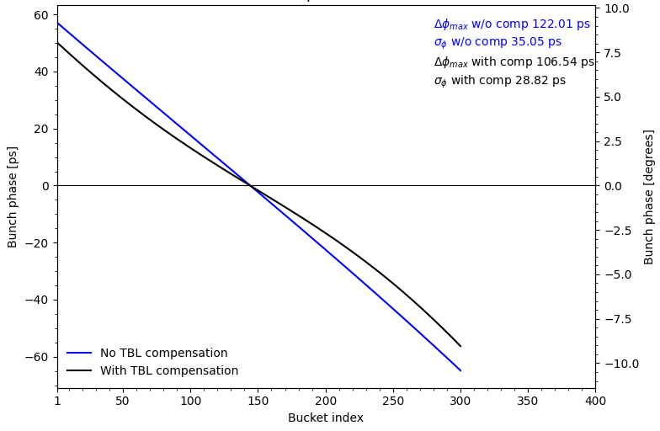
TBL compensation
Compensation applied during 3HC commissioning in BESSY II.
Current: 300 mA, Main RF Voltage: 0.7 MV (2 cavities parked, 2 with detuning -25 deg.), Landau cavities: parked, Fill pattern: 25% gap, 3HC: 130 kV (detuning 0 deg).
TBL compensated from 114 ps to 102 ps: -10,5 %.
Avalanche Photo Diode arrival time
with and w/o compensation measurements
Bunch phase arrival time
with and w/o compensation simulation

Slide 23
Summary
ALBA II construction and operation budget approved and expected to be ready for users in 2032.
Harmonic RF system based in harmonic EU cavity will be installed in 2026.
Harmonic EU cavity commissioned together with HZB and DESY and meets design parameters.
ALBA LLRF firmware has been developed over years and exported to other facilities and ALBA stays open for collaborations.
SAFRAN provided custom made hardware design, firmware controllers and Device Server generator.
Performance of the new LLRF system meets the required specifications and is already in operation in all ALBA cavities.
LLRF firmware includes all previous functionalities and adds new like the harmonic resonant feedback.
Harmonic feedback can be used to mitigate the effects of the TBL in the beam.

Slide 25
Back up slides

Slide 26
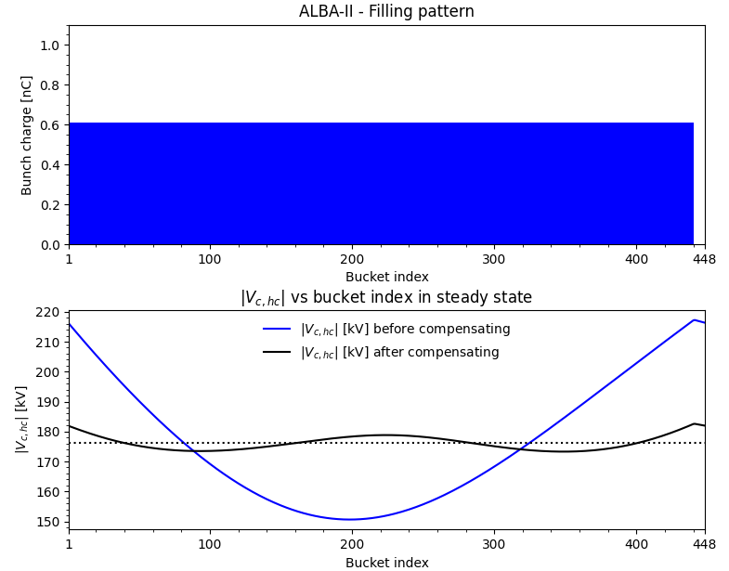
ALBA II TBL

Slide 27

ALBA II TBL

Slide 28

ALBA II TBL

